Slide 1
nush.hack
$ ./lighthouse --event “nush hack”
lighthouse: offline-first cybersecurity checklists
Zhuoxuan, Yiming, Xiaofan
Notes:
Hi everyone. We're Xiaofan, Zhuoxuan and Yiming. And this is Lighthouse: offline-first cybersecurity checklists.

Slide 2
$ our team
Zhuoxuan
Xiaofan
Yiming
Coder
Slides Designer
Debugging
nush hack 26
Notes:
Zhuoxuan wrote the code, I designed the slides and Yiming did the debugging.

Slide 3
$ problem.txt
Build an app that lets safety personnel keep completing security processes offline and syncs their changes correctly when internet access returns.
The hard parts: no lost work, no duplicates or conflicts on reconnect.
Notes:
The challenge was to build an app that lets safety personnel keep completing security processes with no internet, then syncs their changes correctly when it returns. The hard part is making sure no work is lost and that reconnecting creates no duplicates or conflicts.

Slide 4
$ ./lighthouse --solve
1. work offline
2. sync correctly
3. trust the record
Every step is saved to a local SQLite database and queued in an outbox. The app never needs the server to record progress.
Unique event ids make retries safe, a since token pulls only new events, and the outbox clears only after the server confirms.
Completed wins when devices disagree, and a hash-chained audit log shows if anyone tampers with history.
Notes:
We solved it in three steps. First, work offline. Every step is saved to a local SQLite database and queued in an outbox, so the app never needs the server to record progress. Second, sync correctly. Every event has a unique id so retries are safe and the outbox only clears once the server confirms. Third, trust the record. If two devices disagree, "completed" wins and a hash-chained audit log shows if anyone tampers with history.

Slide 5
$ ls lighthouse/
processes.py
server.py
app.py
run.py
Shared checklists: the data both sides use.
FastAPI + SQLite sync server and 4-page web dashboard.
PyQt6 desktop client with a local database.
One command to start the server and clients.
app.py <-- sync --> server.py, both importing processes.py
Notes:
The project has four files. processes.py holds the shared checklists, server.py is the sync server and web dashboard, app.py is the desktop client, and run.py starts everything with one command.

Slide 6
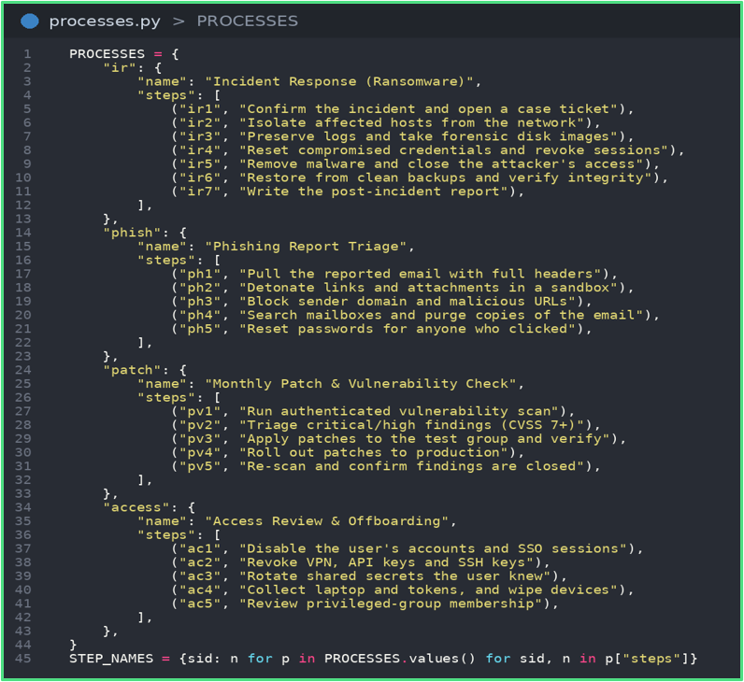
$ processes.py
PROCESSES: 4 built-in checklists (ransomware response, phishing triage, patching, offboarding) with 22 steps in total.
STEP_NAMES: flat lookup from step id to readable name.
Imported by both app.py and server.py, so client and server never disagree.
Step ids are unique, which is what makes syncing safe.
Checklists added on the dashboard are not in this file. They live in server.db.
Notes:
This file holds four built-in checklists with 22 steps in total. Both the client and the server import it, so they never disagree, and its unique step ids are what makes syncing safe.

Slide 7
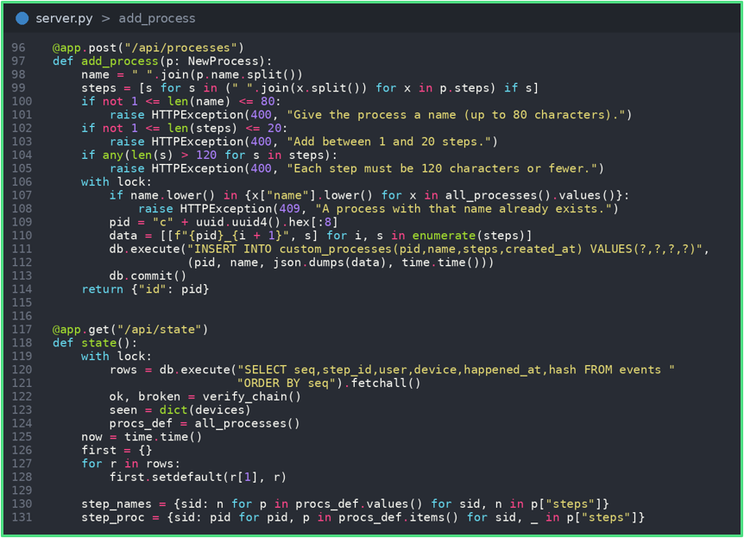
$ cat server.py
POST /sync: accepts events, returns new ones. UNIQUE event_id makes retries harmless.
Each event stores a SHA-256 hash of itself plus the previous hash: a chain.
GET /verify re-checks the chain and reports where it breaks.
POST /api/processes: new. Checks the name and steps, then saves the checklist to custom_processes.
GET /api/state: merges built-in and added checklists, with per-user stats. First completion of a step wins.
Notes:
The main endpoint is POST /sync, which takes in events and returns new ones. Since event ids are unique, retries do not harm. Each event also stores a SHA-256 hash of itself plus the previous one, forming a chain. /verify re-checks it and shows exactly where it breaks.

Slide 8
$ ls dashboard/
home
processes
add process
accounts
Progress ring, stats, chain status and the audit log.
Open a checklist to see who did each step.
Build a new checklist with a live preview.
Each person’s steps, devices and last activity.
browser -> http://localhost:8000 · refreshes every 2 seconds
Notes:
The web dashboard has four pages: home with progress and the audit log, processes to see who did each step, add process to build a new checklist, and accounts.

Slide 9
$ ./lighthouse --add-process
1. fill the form
2. server checks
3. all see it
On the Add process page, name the checklist and list its steps. A live preview updates as you type.
POST /api/processes trims the text, allows 1 to 20 steps and rejects a duplicate name.
It is saved with a new id, merged into /api/state and tagged Added on the Processes page.
Notes:
On the add process page, you name a checklist and list its steps, with a live preview. The server checks there are one to twenty steps and rejects duplicate names. Then, it is saved, merged and tagged, so everyone can see it.

Slide 10
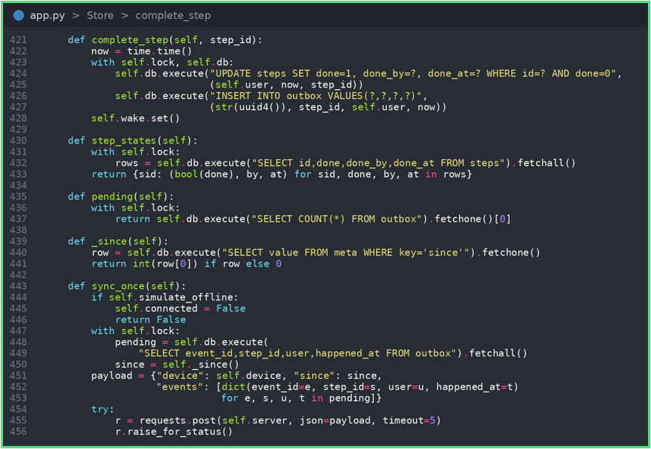
$ app.py # part 1: Store
complete_step updates the step and queues an outbox row in one transaction: both or neither.
sync_once pushes the outbox, then pulls events newer than a saved since token.
Outbox rows are deleted only after the server confirms them.
sync_loop retries with backoff while offline. Merge rule: completed wins.
Notes:
On the client, completing a step updates it and queues an outbox row in one transaction. Both happen or neither does, so nothing is lost. Sync pushes the outbox, then pulls only newer events. Rows are deleted only after the server confirms them and while offline it keeps retrying.

Slide 11
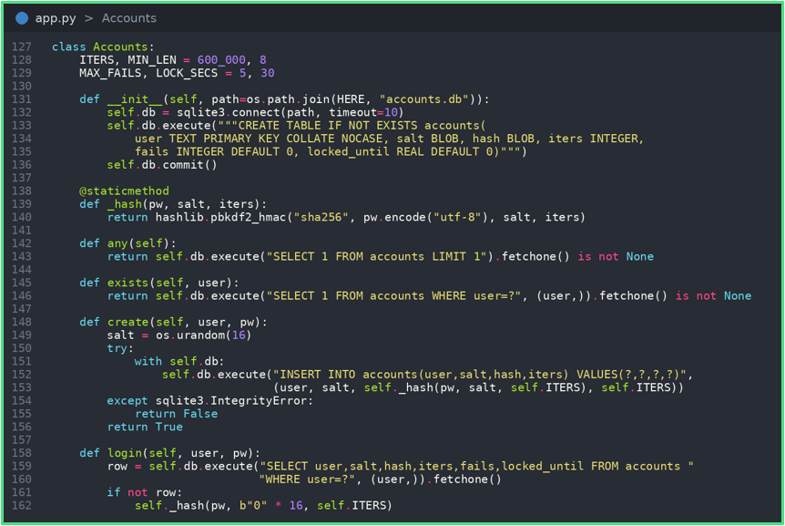
$ app.py # part 2: UI + security
Accounts: random salt, PBKDF2-SHA256 at 600,000 iterations, constant-time compare.
Five wrong passwords lock the account for 30 seconds, and the count survives restarts.
Animated widgets: CheckBox, StepRow, Toast, Pulse status dot.
ServerFeed polls /api/state for the team dashboard. An offline toggle demos the sync.
The desktop client lists the 4 built-in checklists. Added ones show on the web dashboard.
Notes:
For security, passwords use a random salt and PBKDF2 at 600,000 iterations. Five wrong attempts lock the account for 30 seconds and that survives restarts. The client has an offline toggle, which is how we demo syncing. One limit: the desktop app shows the four built-in checklists and added ones appear on the web dashboard.

Slide 12
$ run.py
Starts server.py and waits until /api/state answers (about 12 seconds max). Dashboard: localhost:8000.
Opens one app.py window per name: python run.py Ali Bob shows sync live.
python run.py stop stops a leftover server via server.pid.
Works from VS too: swaps pythonw.exe for python.exe. Logs go to server.log and client logs.
Notes:
run.py starts the server, waits until it's ready and opens one window per name. Running python run.oy Ali Bob shows syncing live.

Slide 13
thank you
$ exit 0
Questions?
Notes:
Thank you for listening. Any questions?

